Slide 1




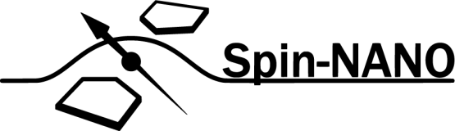
A Multi-Node Quantum Network with Defects in Diamond
Ph.D. Proposal - Matteo Pompili

Slide 2
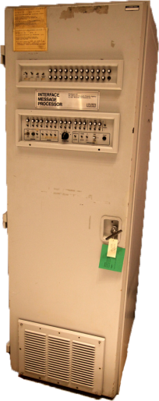

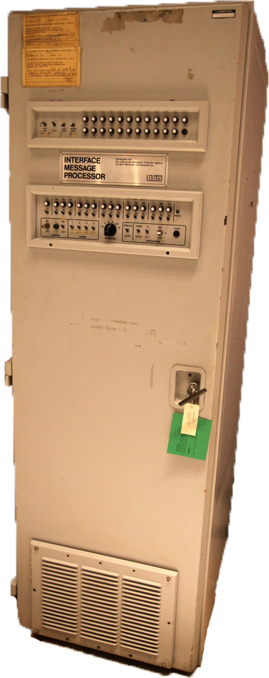
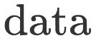
What is a (Quantum) Network?

Slide 3
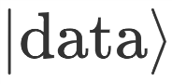
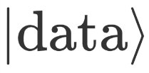
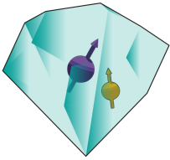

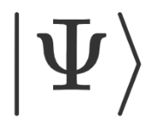
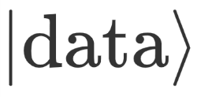

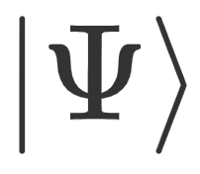

What is a (Quantum) Network?

Slide 4




What is a (Quantum) Network?
Known applications:
Quantum Key Distribution (QKD)
Blind quantum computation
Distributed quantum computation
Clock Synchronization
Leader election
…

Slide 5
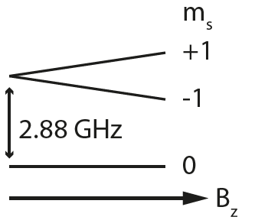
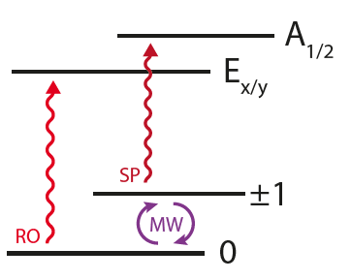
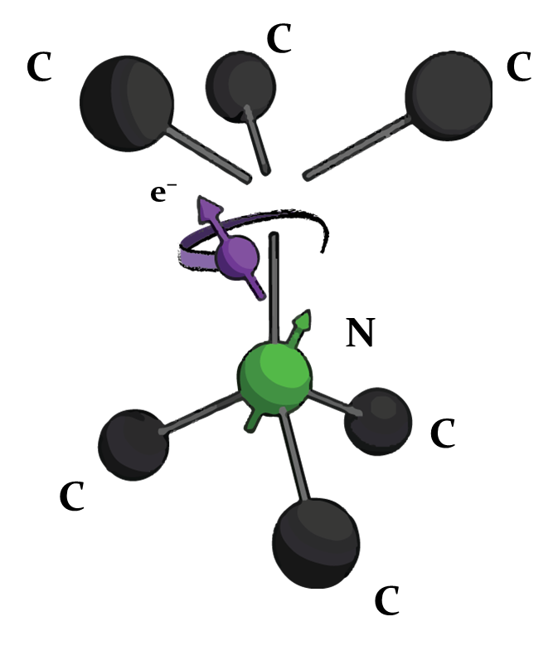

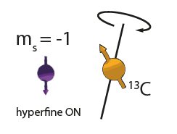
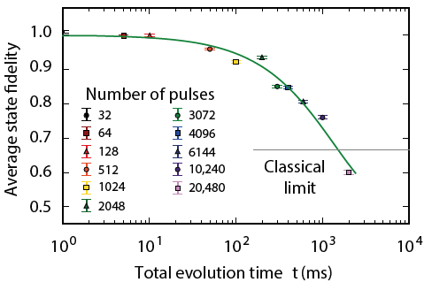
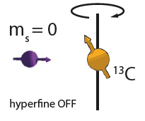
The Nitrogen Vacancy Centre in Diamond
C¹³
M. H. Abobeih et al. Nature Comm. 2018.
C¹³

Slide 6
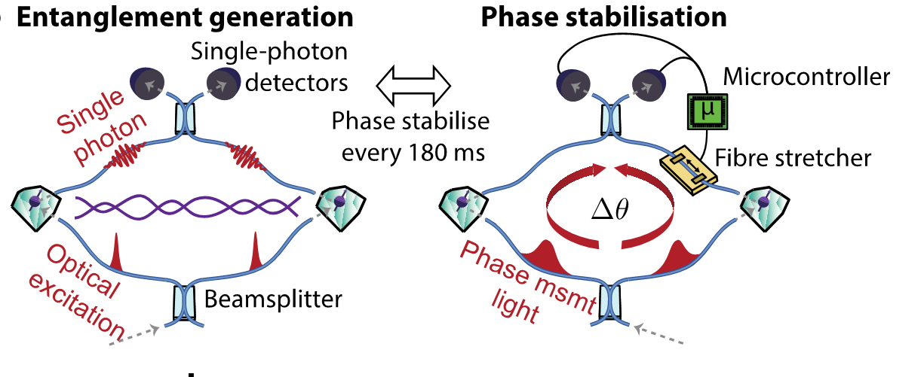
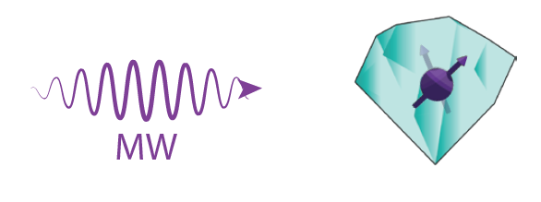
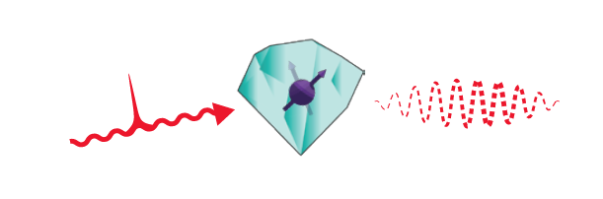
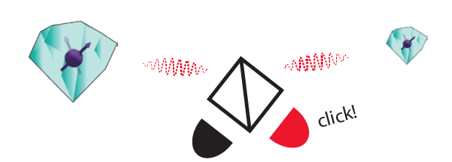
Single Click Entanglement
P C Humphreys et al., Nature 558, 268–273 (2018)

Slide 7
Research goals
Demonstration of quantum applications on a multi-node network
Generation of genuine multipartite entangled states,
Proof of principle demonstration of the Link layer of the future Quantum Internet stack,
Teleportation of entanglement in a four node network,
Client-Server secure delegation of quantum computation.

Slide 8
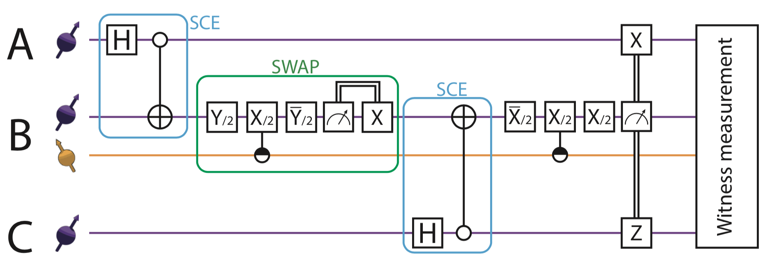
Genuine Multipartite Entanglement

Slide 9
Genuine Multipartite Entanglement
During first year:
Built third node (LT5)
Tested improvements for all setups:
Faster microprocessor
Fibre based laser combining
Improved control of laser pulses
Faster phase stabilisation

Slide 10
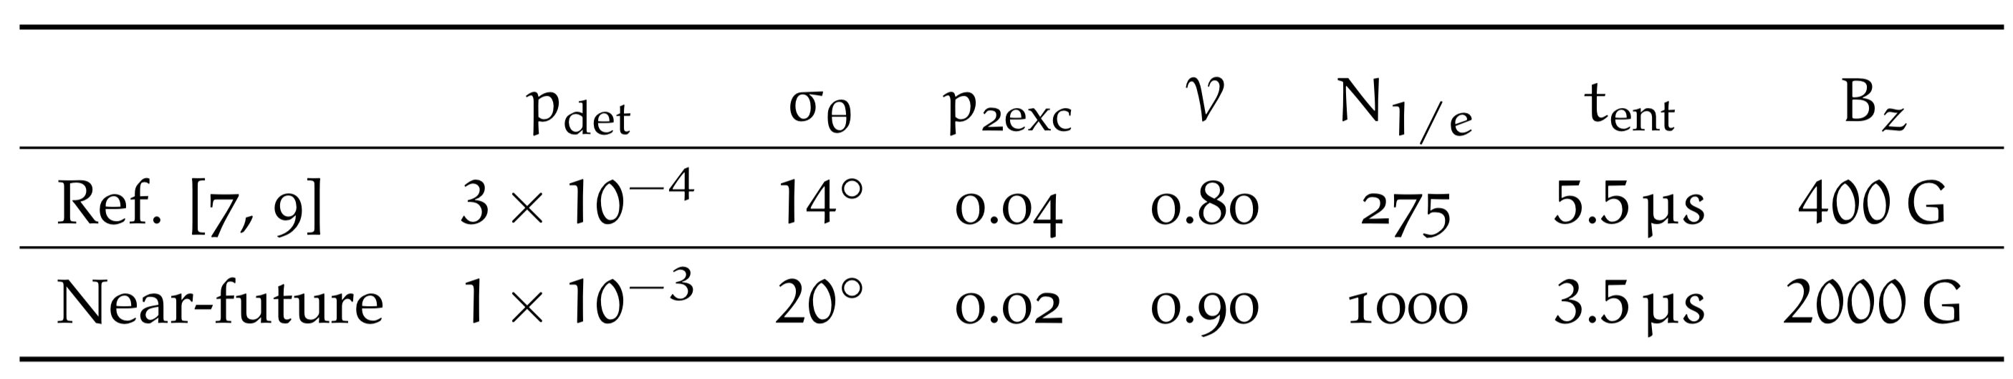
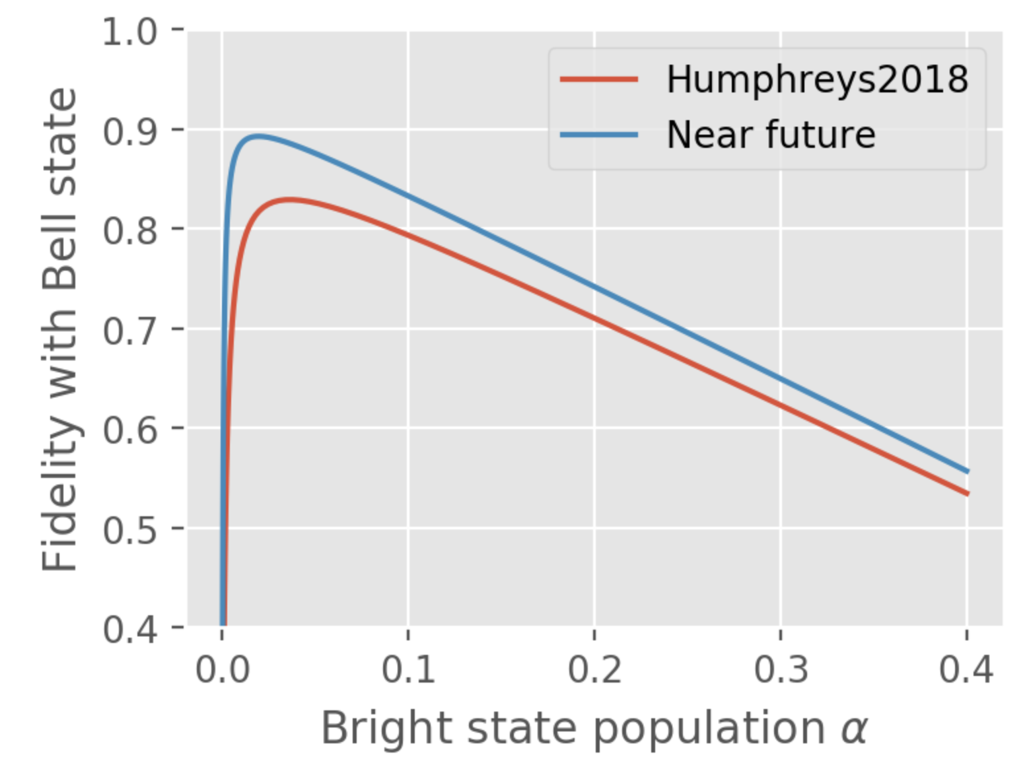
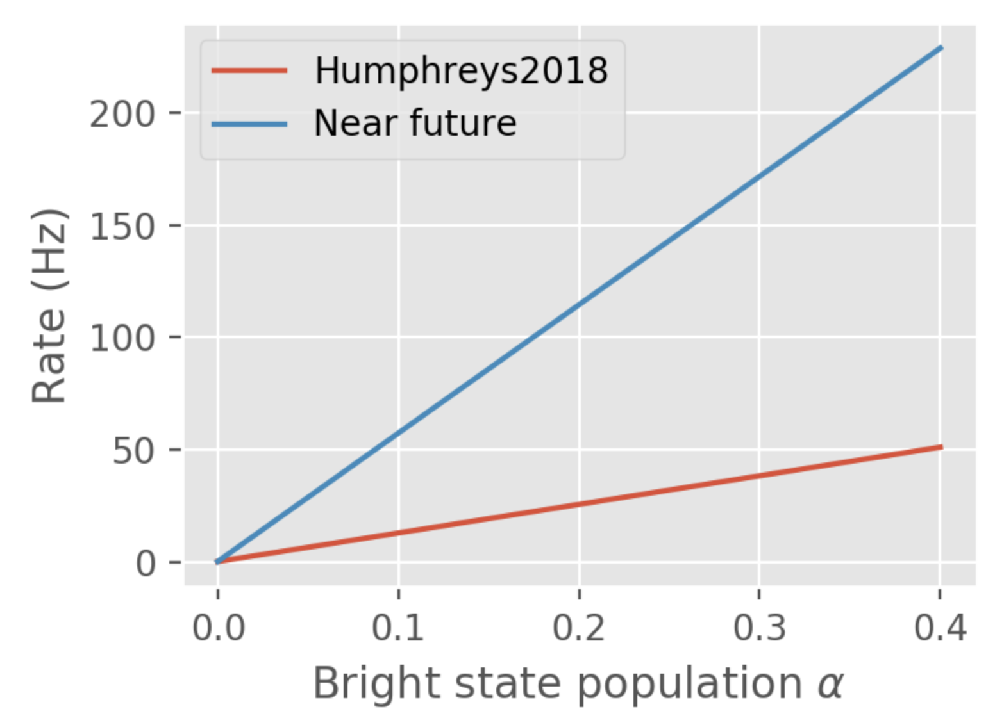
Genuine Multipartite Entanglement

Slide 11
Link Layer Demonstration

Slide 12
Teleportation of Entanglement

Slide 13
Client-Server Secure Delegation

Slide 14
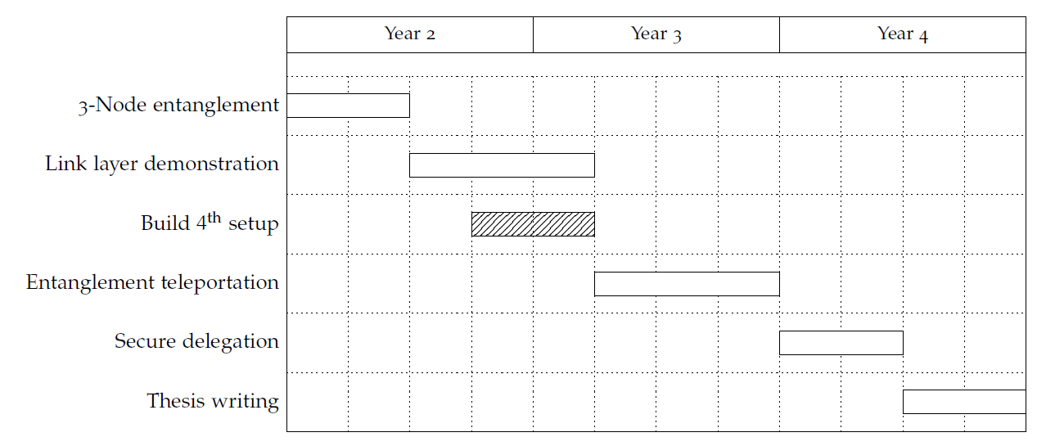
Proposed Ph.D. Timeline

